Slide 1
California Department of Public Health
Licensing and Certification Program
Orange County District Office
RAP Session Presentation
June 26, 2019

Slide 2
Emergency Preparedness
Jose Gonzalez
Life Safety Code Unit Supervisor

Slide 3
Disclaimer
This presentation was prepared as a service to the public and is not intended to grant rights or impose obligations. This presentation may contain references or links to statutes, regulations, or other policy materials. The information provided is only intended to be a general summary. It is not intended to take the place of either the written law or regulations. We encourage readers to review the specific statutes, regulations, and other interpretive materials for a full and accurate statement of contents.

Slide 4
Final Rule (81 FR 63860)
Facilities participating in the Medicare and/or Medicaid Programs are required to meet the Emergency Preparedness Requirements set forth in Title 42 of the Code of Federal Regulations (CFR).
Requirements for Long-Term Care (LTC) Facilities: CFR §483.473
Condition of Participation for Intermediate Care Facilities for Individuals with Intellectual Disabilities (ICF/IID): CFR §483.475
These regulations went into effect on November 16, 2016
Implementation date November 15, 2017

Slide 5
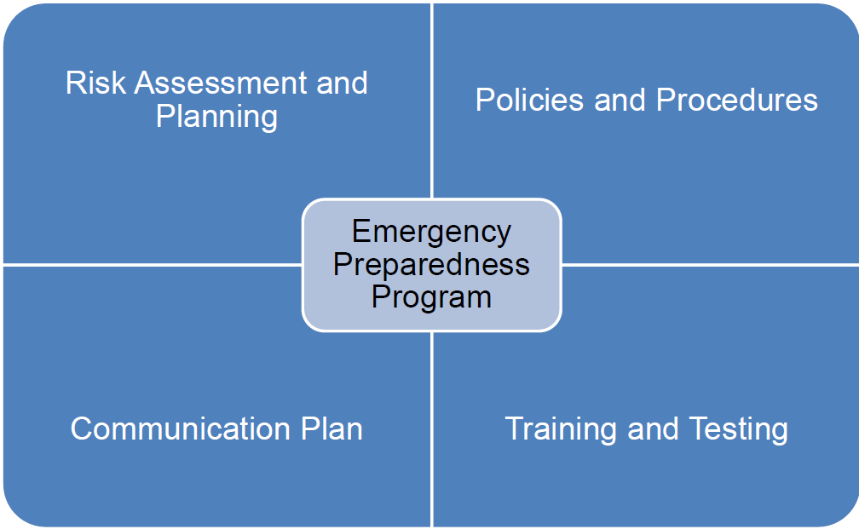
Four Provisions

Slide 6
Risk Assessment and Planning
Develop an emergency plan based on a risk assessment.
Perform risk assessment using an “all-hazards” approach, focusing on capacities and capabilities.
Update emergency plan at least annually.

Slide 7
All-Hazards Approach:
An all-hazards approach is an integrated approach to emergency preparedness planning that focuses on capacities and capabilities that are critical to preparedness for a full spectrum of emergencies or disasters, including internal emergencies and a man-made emergency (or both) or natural disaster. This approach is specific to the location of the provider or supplier and considers the particular type of hazards most likely to occur in their areas. These may include, but are not limited to, care-related emergencies, equipment and power failures, interruptions in communications, including cyber-attacks, loss of a portion or all of a facility, and interruptions in the normal supply of essentials such as water and food.

Slide 8
Policies and Procedures
Develop and implement policies and procedures based on the emergency plan and risk assessment.
Policies and procedures must address a range of issues including subsistence needs, evacuation plans, procedures for sheltering in place, tracking patients and staff during an emergency.
Review and update policies and procedures at least annually.

Slide 9
Communication Plan
Develop a communication plan that complies with both Federal and State laws.
Coordinate patient care within the facility, across health care providers, and with state and local public health departments and emergency management systems.
Review and update plan annually.

Slide 10
Training and Testing Program
Facilities are expected to meet all Training and Testing Requirements by the implementation date (11/15/17).
  Develop and maintain training and testing programs, including initial training of policies and procedures.
  Provide training to all staff at least annually and demonstrate knowledge of emergency procedures.
  Conduct drills and exercises to test the emergency plan.

Slide 11
Training & Testing Requirements
  Participation in a full-scale exercise that is community-based or when a community-based exercise is not accessible, an individual, facility-based exercise.
  Conduct an additional exercise that may include, but is not limited to the following:
    A second full-scale exercise that is individual, facility-based.
    A tabletop exercise that includes a group discussion led by a facilitator, using a narrated, clinically-relevant emergency scenario, and a set of problem statements, directed messages, or prepared questions designed to challenge an emergency plan.

Slide 12
Training & Testing Program Definitions
Facility-Based: When discussing the terms “all-hazards approach” and facility-based risk assessments, we consider the term “facility-based” to mean that the emergency preparedness program is specific to the facility. Facility-based includes, but is not limited to, hazards specific to a facility based on the geographic location; Patient/Resident/Client population; facility type and potential surrounding community assets (i.e. rural area versus a large metropolitan area).
Full-Scale Exercise: A full scale exercise is a multi-agency, multijurisdictional, multi-discipline exercise involving functional (for example, joint field office, emergency operation centers, etc.) and/or ‘‘boots on the ground’’ response (for example, firefighters decontaminating mock victims).

Slide 13
Training & Testing Program Definitions
Table-top Exercise (TTX): A table-top exercise is a group discussion led by a facilitator, using narrated, clinically-relevant emergency scenario, and a set of problem statements, directed messages, or prepared questions designed to challenge an emergency plan. It involves key personnel discussing simulated scenarios, including computer-simulated exercises, in an informal setting. TTXs can be used to assess plans, policies, and procedures.

Slide 14
Training & Testing Requirements Continued
Providers are encouraged to seek out local state emergency agencies and health care coalitions to participate in a full-scale, community-based exercise.
Interpretive Guidelines (IGs) can be found in the CMS website in the State Operations Manual - Appendix Z - Emergency Preparedness
(latest update 3/4/19)
The IGs are sub regulatory guidelines which establish our expectations for the function surveyors perform in enforcing the regulatory requirements.

Slide 15
The Emergency Prep Website
Providers should refer to the resources on the CMS website for assistance in developing emergency preparedness plans.
The website also provides important links to additional resources and organizations who can assist.
https://www.cms.gov/Medicare/Provider-Enrollment-and-Certification/SurveyCertEmergPrep/index.html

Slide 16


Slide 17
Thank You!
101

